Slide 1
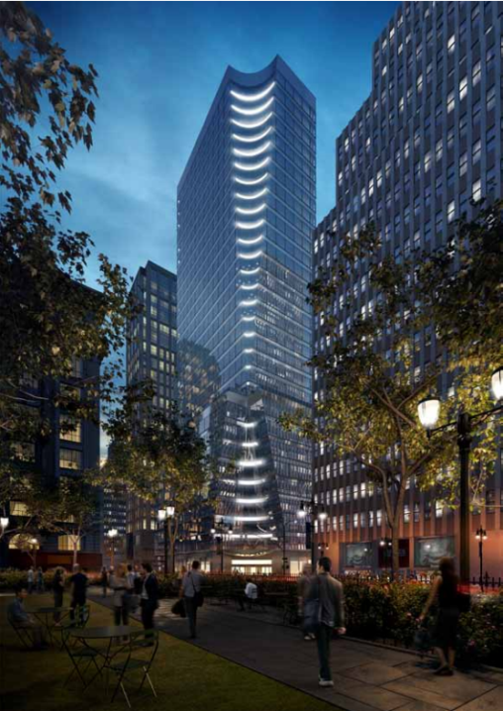
The Tower
PENN STATE AE SENIOR THESIS PROJECT
SHIVAM PATEL|CONSTRUCTION MANAGEMENT OPTION
ADVISOR: DR GANNON

Slide 2
The Tower
RESEARCH TOPIC
MATERIAL TRACKING TECHNOLOGIES
ANALYSIS # 2
IMPLEMENTATION OF PHOTOVOLTAIC CURTAIN WALL
*STRUCTURAL BREADTH
*ELECTRICAL BREADTH
ANALYSIS # 1
GUIDED FORMWORK TO SELF CLIMBING
ANALYSIS # 3
SIPS
PENN STATE AE SENIOR THESIS PROJECT
SHIVAM PATEL|CONSTRUCTION MANAGEMENT OPTION
ADVISOR: DR GANNON

Slide 3
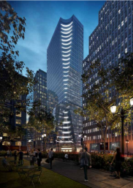


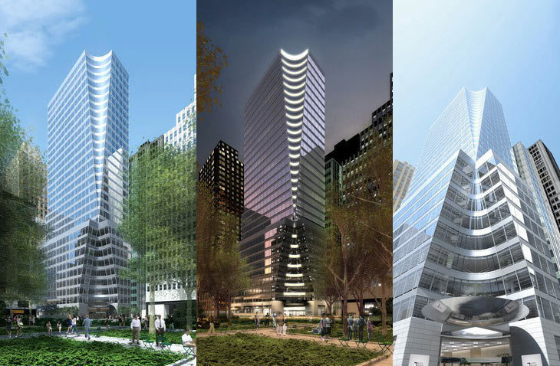
PENN STATE AE SENIOR THESIS PROJECT
SHIVAM PATEL|CONSTRUCTION MANAGEMENT OPTION
ADVISOR: DR GANNON
Turner Construction Company
Hines
PROJECT BACKGROUND
BUILDING PARAMETERS
COMMERCIAL HIGH RISE
AREA: 475, 000 GSF
# OF FLOORS: 32
PROJECT PARAMETERS
COST: $208 M
CONTRACT TYPE: GMP
DELIVERY METHOD: CM AT Risk
TIMELINE: 12/24/12 – 3/3/15 (26 months)
PROJECT BACKGROUND
RESEARCH TOPIC: MATERIAL TRACKING
ANALYSIS #1: GUIDED FORMWORK TO SELF CLIMBING
ANALYSIS #2: PHOTOVOLTAIC CURTAIN WALL
ANALYSIS #3: SIPS
CONCLUSIONS
BUILDING PARAMETERS
ACKNOWLEGEMENTS
Photo provided of Hines

Slide 4
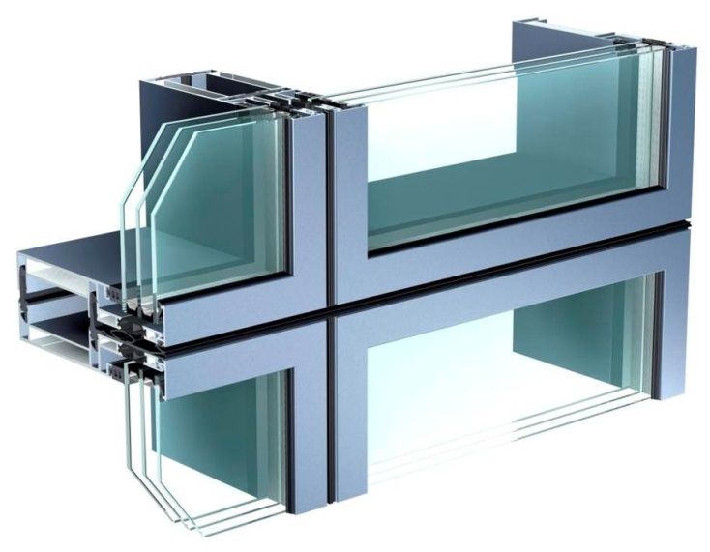
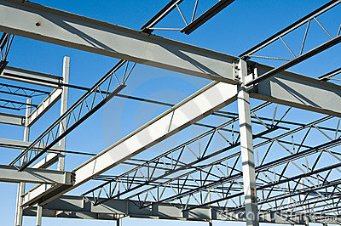
PENN STATE AE SENIOR THESIS PROJECT
SHIVAM PATEL|CONSTRUCTION MANAGEMENT OPTION
ADVISOR: DR GANNON
Turner Construction Company
Hines
MATERIAL TRACKING TECHNOLOGY
PROJECT BACKGROUND
ACKNOWLEGEMENTS
CONCLUSIONS
ANALYSIS #3: SIPS
ANALYSIS #2: PHOTVOLTAIC CURTAIN WALL
ANALYSIS #1: GUIDED FORMWORK TO SELF CLIMBING
SUMMARY
RESEARCH TOPIC: MATERIAL TRACKING
Summary
Material Tracking can increase productivity and decrease delays
Complex Coordination
$6,900 additional cost
Recommend Implementation
Photos provided by google images
Notes:
Pre-Fab Materials offsite
Due to Site restrictions and location, Deliveries are complicated. (Site surrounded by one ways streets)
Material Tracking growing in industry
Software such as BIM 360 Field allows easy compatibility
Bartender for Barcode labels are cheapest
Coordination with project team, subcontractors, and manufactures is complicated but is needed in order to be successful.

Slide 5
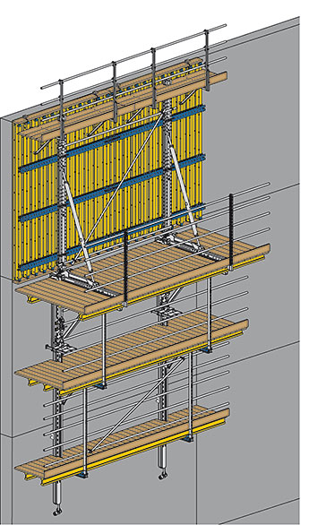
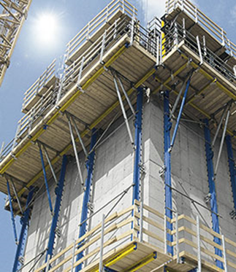
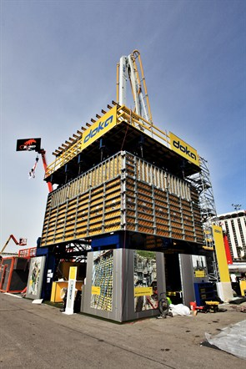
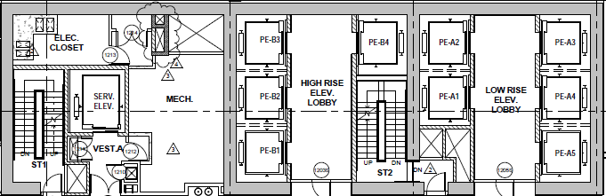
PENN STATE AE SENIOR THESIS PROJECT
SHIVAM PATEL|CONSTRUCTION MANAGEMENT OPTION
ADVISOR: DR GANNON
Turner Construction Company
Hines
GUIDED FORMWORK TO SELF CLIMBING
PROBLEM
One full work day to lift system
Multiple lifts
Safety Concerns
Background
X Climb 60 manufactured by Doka
Guiding Shoes and Hydraulic Lifts are used
26 lifts
PROJECT BACKGROUND
RESEARCH TOPIC: MATERIAL TRACKING
ANALYSIS #1: GUIDED FORMWORK TO SELF CLIMBING
ANALYSIS #2: PHOTOVOLTAIC CURTAIN WALL
ANALYSIS #3: SIPS
CONCLUSIONS
ACKNOWLEGEMENTS
INTRODUCTION TO ANALYSIS
Photos provided by Doka
Layout provided by Turner
Notes:
Current system in place is Xclimb 60
Uses Guiding shoes and hydraulic lifts in order to lift form wall
Change to Super Climber

Slide 6
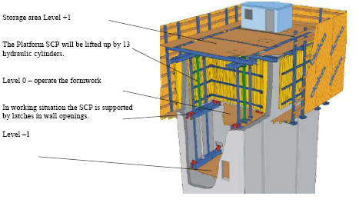
PENN STATE AE SENIOR THESIS PROJECT
SHIVAM PATEL|CONSTRUCTION MANAGEMENT OPTION
ADVISOR: DR GANNON
Turner Construction Company
Hines
GUIDED FORMWORK TO SELF CLIMBING
Background
Super Climber manufactured by Doka
Interior and exterior formwork raised all at once
Closed System
PROJECT BACKGROUND
RESEARCH TOPIC: MATERIAL TRACKING
ANALYSIS #1: GUIDED FORMWORK TO SELF CLIMBING
ANALYSIS #2: PHOTOVOLTAIC CURTAIN WALL
ANALYSIS #3: SIPS
CONCLUSIONS
ACKNOWLEGEMENTS
SUPER CLIMBER SCP FORMWORK
Photos provided by Doka
Notes:
Super Climber safer closed system
Raised all at once by hydraulic jacks
Three Working levels

Slide 7
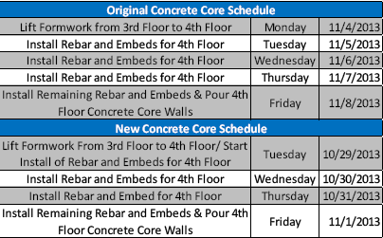
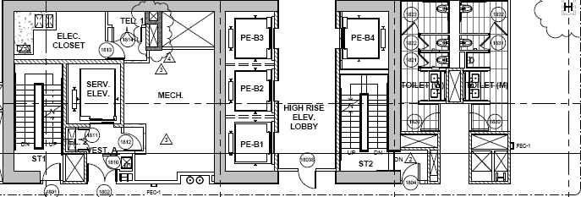
PENN STATE AE SENIOR THESIS PROJECT
SHIVAM PATEL|CONSTRUCTION MANAGEMENT OPTION
ADVISOR: DR GANNON
Turner Construction Company
Hines
GUIDED FORMWORK TO SELF CLIMBING
Current Schedule
Five Day Cycle (Three Bay System)
Four Day Cycle (Two Bay System)
Proposed Schedule
Four Day Cycle (Three Bay System)
Three Day Cycle (Two Bay System)
Results
Saves 30 working days
PROJECT BACKGROUND
RESEARCH TOPIC: MATERIAL TRACKING
ANALYSIS #1: GUIDED FORMWORK TO SELF CLIMBING
ANALYSIS #2: PHOTOVOLTAIC CURTAIN WALL
ANALYSIS #3: SIPS
CONCLUSIONS
ACKNOWLEGEMENTS
CURRENT VS PROPOSED SCHEDULE
Photos provided by Turner
Notes:
Typical work week seen on right
Three bay (LL2-17)
Two bay system (Floors 18-29)
Experienced contractors with super climber, system lifts within an hour. Stripping form takes roughly 3 to 4 hours (Half work day)

Slide 8
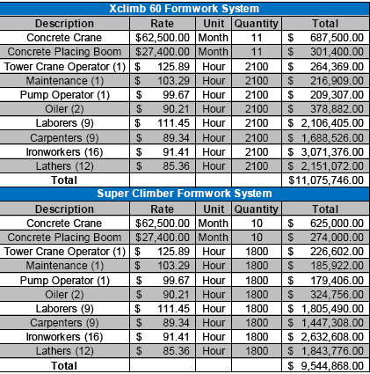
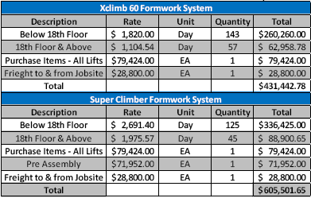
PENN STATE AE SENIOR THESIS PROJECT
SHIVAM PATEL|CONSTRUCTION MANAGEMENT OPTION
ADVISOR: DR GANNON
Turner Construction Company
Hines
GUIDED FORMWORK TO SELF CLIMBING
PROJECT BACKGROUND
RESEARCH TOPIC: MATERIAL TRACKING
ANALYSIS #1: GUIDED FORMWORK TO SELF CLIMBING
ANALYSIS #2: PHOTOVOLTAIC CURTAIN WALL
ANALYSIS #3: SIPS
CONCLUSIONS
ACKNOWLEGEMENTS
COST ANALYSIS
System Expense
$174,000 Difference
Labor Savings
$1.5 Million Saved
Notes:
Maritha Buckley from Doka gave me cost data for both formwork systems
Jon ingerson gave me cost data for the

Slide 9
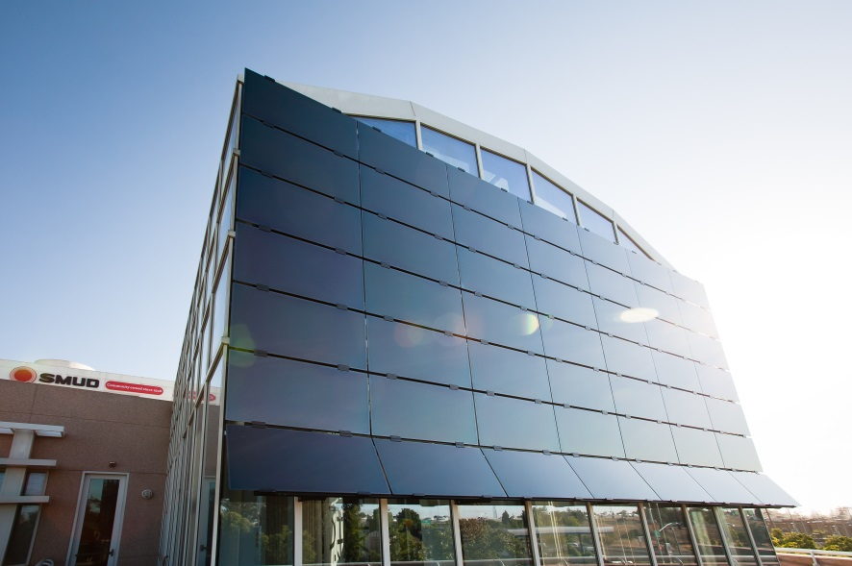
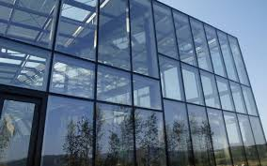
PENN STATE AE SENIOR THESIS PROJECT
SHIVAM PATEL|CONSTRUCTION MANAGEMENT OPTION
ADVISOR: DR GANNON
Turner Construction Company
Hines
PHOTOVOLTAIC CURTAIN WALL
PROJECT BACKGROUND
RESEARCH TOPIC: MATERIAL TRACKING
ANALYSIS #1: GUIDED FORMWORK TO SELF-CLIMBING
ANALYSIS #2: PHOTVOLTAIC CURTAINWALL
ANALYSIS #3: SIPS
CONCLUSIONS
ACKNOWLEGEMENTS
INTRODUCTION TO ANALYSIS
Background
Photovoltaic Arrays becoming increasingly popular
Reduces amount of electricity purchased
Federal and State incentives
Adds value
Photos provided by Google Images
Notes:
Can be panels or glass modules
Payback period can decrease through the use of federal and state incentives

Slide 10
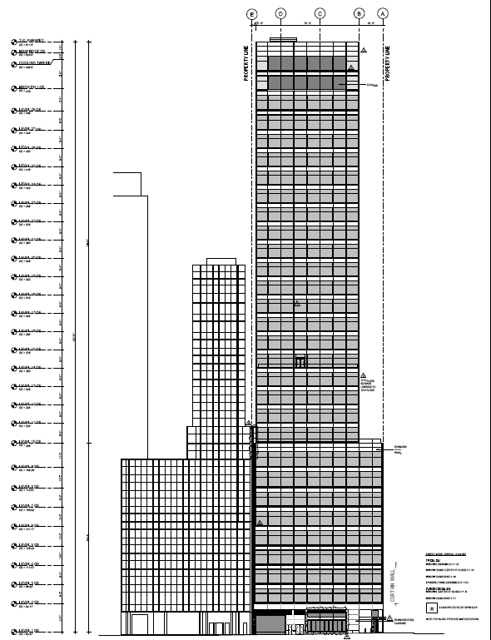
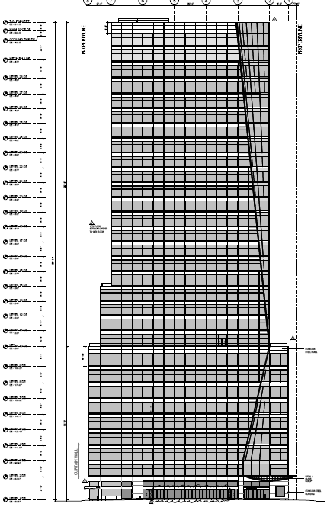
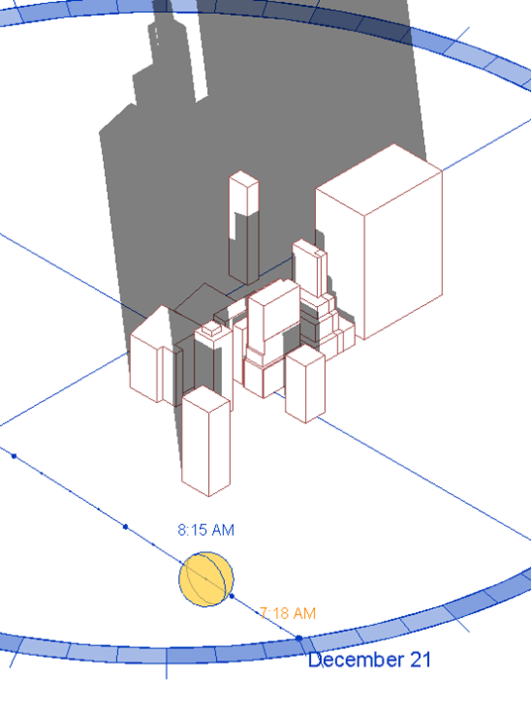
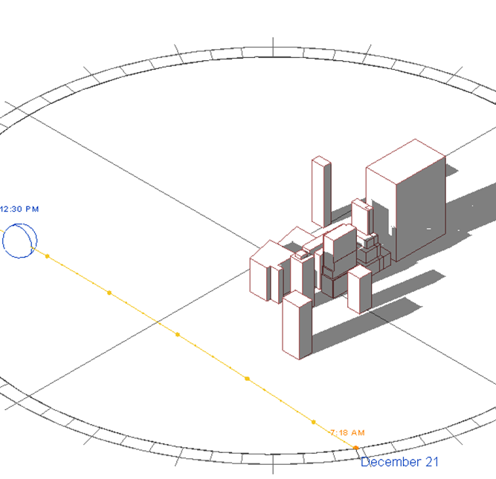
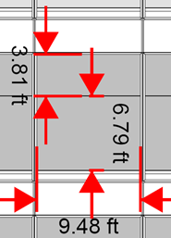
PENN STATE AE SENIOR THESIS PROJECT
SHIVAM PATEL|CONSTRUCTION MANAGEMENT OPTION
ADVISOR: DR GANNON
Turner Construction Company
Hines
Solar Study
Determined area of installation
Floors 19-28 (East Side)
Floors 25-28 (South Side)
264 PV Units
13,500 Square Feet
PHOTOVOLTAIC CURTAIN WALL
PROJECT BACKGROUND
RESEARCH TOPIC: MATERIAL TRACKING
ANALYSIS #1: GUIDED FORMWORK TO SELF-CLIMBING
ANALYSIS #2: PHOTVOLTAIC CURTAINWALL
ANALYSIS #3: SIPS
CONCLUSIONS
ACKNOWLEGEMENTS
SOLAR STUDY
Photos provided by Turner
Notes:
Solar study needed to determine installation area, and where shadows are at their highest
Building is 450’ tall and is tallest in vicinity. Google Skeptup model into revit to determine the height of shadows. From this determined installation on east and south side.
Glass dimensions 9.5 X 3.85 and 9.5 by 6.85. Two glass panels separated by horizontal mullion

Slide 11



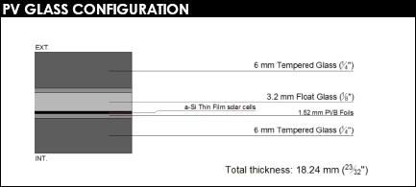
PENN STATE AE SENIOR THESIS PROJECT
SHIVAM PATEL|CONSTRUCTION MANAGEMENT OPTION
ADVISOR: DR GANNON
Turner Construction Company
Hines
Panel Specifications
20% Transparency
Junction Boxes Included
PHOTOVOLTAIC CURTAIN WALL
PROJECT BACKGROUND
RESEARCH TOPIC: MATERIAL TRACKING
ANALYSIS #1: GUIDED FORMWORK TO SELF-CLIMBING
ANALYSIS #2: PHOTVOLTAIC CURTAINWALL
ANALYSIS #3: SIPS
CONCLUSIONS
ACKNOWLEGEMENTS
SIZING AND MANUFACTUERING
Photos provided by Onyx Solar
Notes:
Looked for various pv manufactures. Determined onyx was best due to experience.
Benson industries are manufactures of curtain wall. Jeff Rosenburg, after mockup testing is complete, full production will take place. I,e order necessary materials such as the glass.
Diego cuevas was my source of information. Determined glass specifications by square footage of panel. Reccommended 20% transparency and junction boxes are included.
PV glass configuration. Included Insulating glass unit. Argon chamber 16 mm thick to make the same thickness as the original panel.

Slide 12
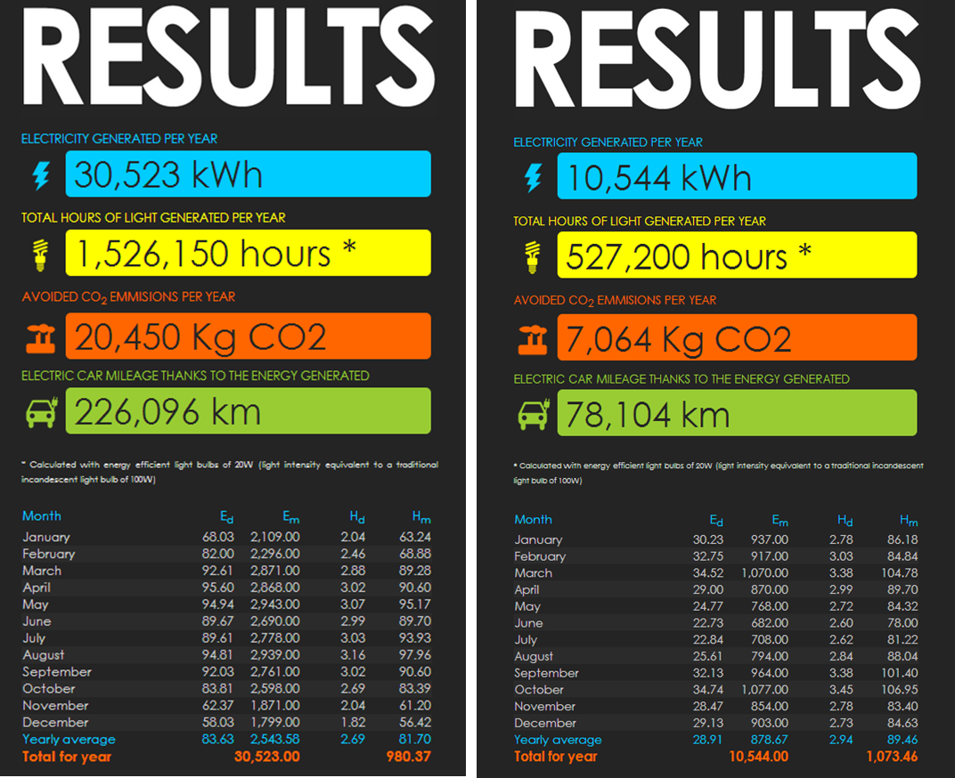
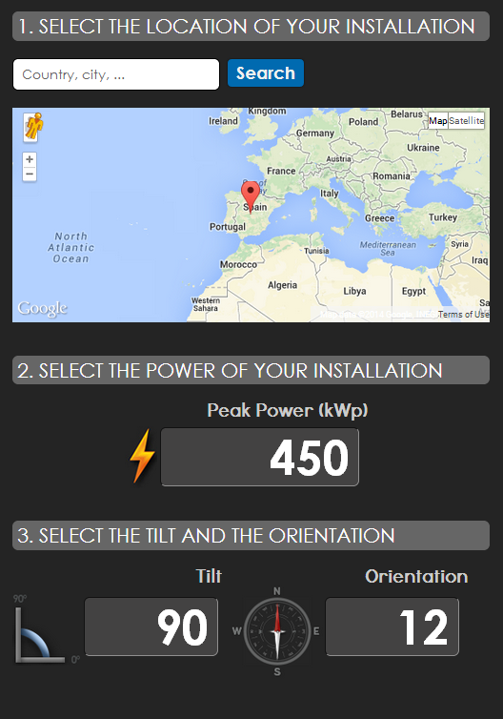
PENN STATE AE SENIOR THESIS PROJECT
SHIVAM PATEL|CONSTRUCTION MANAGEMENT OPTION
ADVISOR: DR GANNON
Turner Construction Company
Hines
PHOTOVOLTAIC CURTAIN WALL
PV Generation
Determined energy generated
Peak Power 37.14 kW and 11.88 kW
PROJECT BACKGROUND
RESEARCH TOPIC: MATERIAL TRACKING
ANALYSIS #1: GUIDED FORMWORK TO SELF-CLIMBING
ANALYSIS #2: PHOTVOLTAIC CURTAINWALL
ANALYSIS #3: SIPS
CONCLUSIONS
ACKNOWLEGEMENTS
PHOTOVOLTAIC GENERATION
Notes:
Needed to determine the energy generated by the panels.
Onyx website has PV estimator

Slide 13
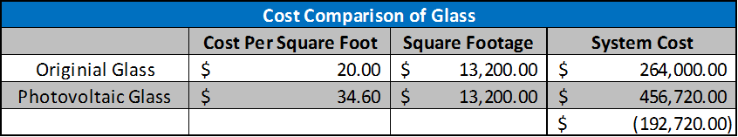
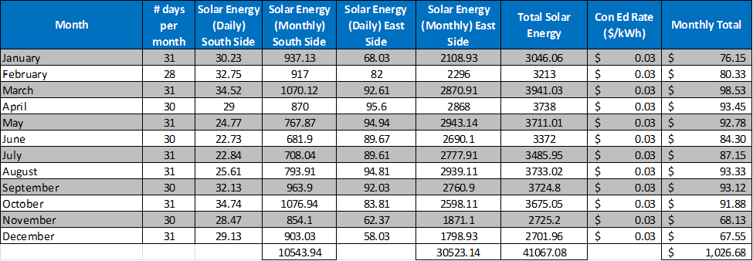
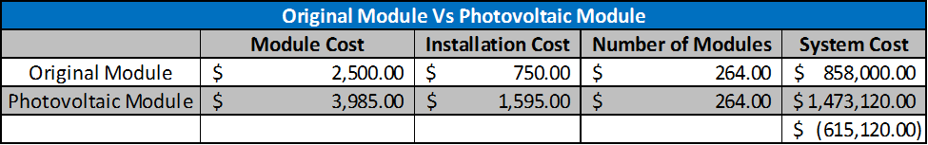
PENN STATE AE SENIOR THESIS PROJECT
SHIVAM PATEL|CONSTRUCTION MANAGEMENT OPTION
ADVISOR: DR GANNON
Turner Construction Company
Hines
PHOTOVOLTAIC CURTAIN WALL
Costs Analysis
Reduces tenants electric bill
Federal and State Incentives
IRS Private Letter Ruling 2009
Energy property is depreciated
30% Investment Tax Credit
Year 1: ($27,109)
Year 2: $112,846
PROJECT BACKGROUND
RESEARCH TOPIC: MATERIAL TRACKING
ANALYSIS #1: GUIDED FORMWORK TO SELF-CLIMBING
ANALYSIS #2: PHOTVOLTAIC CURTAINWALL
ANALYSIS #3: SIPS
CONCLUSIONS
ACKNOWLEGEMENTS
COST ANALYSIS
$2500 – ($20 $\frac{\$}{SF}$ x 101.65 SF) = Cost of Remaining materials = $470
Notes:
The cost difference between the two systems was first determined.
Jeff Rosenburg provided the price per square foot and Diego Cuevas provided the PV glass Cost
Again Jeff provided the cost of the entire module which included the steel, connections etc. Noah Payne from the project team and whom oversees the curtain wall told me to assume 30% for the installation.
By using equation it determined the cost of the remaining materials and this was added to PV glass cost to get the module cost.
With panels installed, the amount of energy gathered would relieve a portion of the electrical demand of the building resulting in a lower monthly bill. Table shows amount of money pv will save
Reduction very low so looked into federal and state tax incentives.
IRS Private Letter Ruling shown to by Tom Peters.
Standard Curtain wall ordinarily depreciates over 39.5 years. This PLR allows the curtain wall to considered energy property when comes to site.
Energy Property is deprecated according to the 5 year Modified Accelerated Cost Recovery System and is also entitled to a 30 % investment tax credit.
With this benefit the return on investment significantly improves.
Owner can use the depreciation as a deduction from other taxable incomes such as rent.
ITC increases the cash flow because it’s a direct deduction.
Year 1 owner is still paying off panels
Year 2 owner sees positive return with $112,000 in savings in taxes.

Slide 14
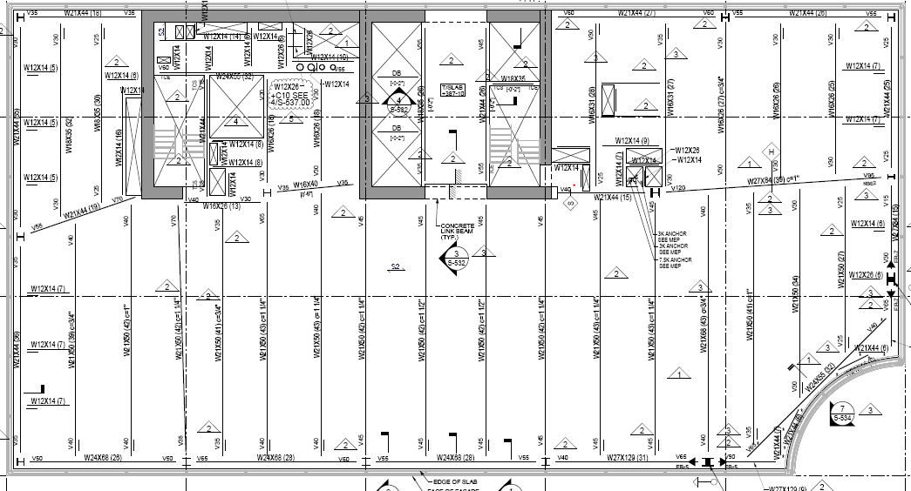
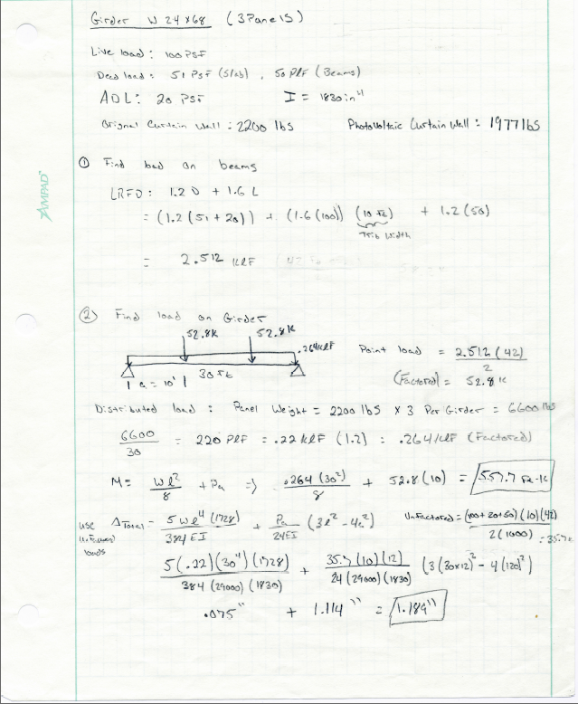
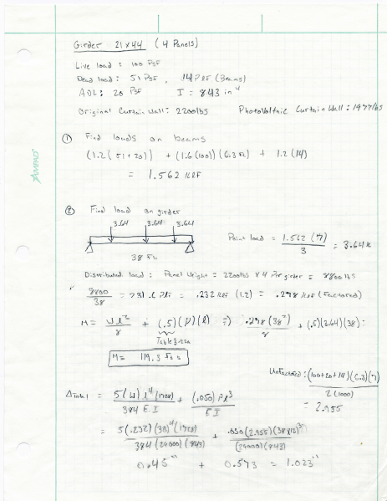
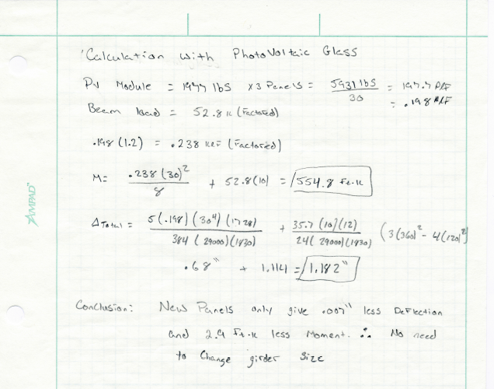
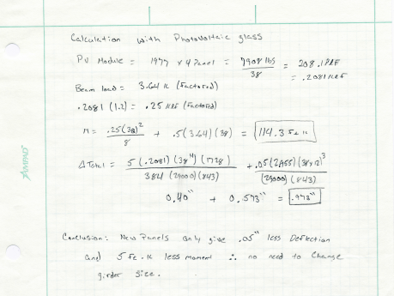
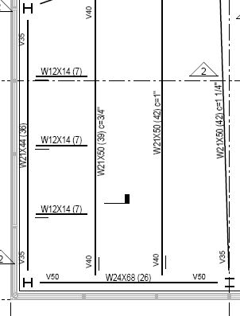
PENN STATE AE SENIOR THESIS PROJECT
SHIVAM PATEL|CONSTRUCTION MANAGEMENT OPTION
ADVISOR: DR GANNON
Turner Construction Company
Hines
PHOTOVOLTAIC CURTAIN WALL
PROJECT BACKGROUND
RESEARCH TOPIC: MATERIAL TRACKING
ANALYSIS #1: GUIDED FORMWORK TO SELF-CLIMBING
ANALYSIS #2: PHOTVOLTAIC CURTAINWALL
ANALYSIS #3: SIPS
CONCLUSIONS
ACKNOWLEGEMENTS
STRUCTURAL BREADTH
Photos provided by Turner
Results
0.007” less Deflection
2.9 ft-k less moment
Results
0.05” less Deflection
5 ft-k less moment
Notes:
Layout of structural steel is same on the floors the panels are installed on
Weights of the panels are different.
Looked at moment and deflection changes for two girders to see if current beam needed to be changed.
W24x68 on east side and W21x44 on the south side.
According to Noah payne, the original module weighs roughly 2200 lbs with the glass weighing roughly 1017 lbs
Various other components weigh roughly 1184 pounds and the PV panels weigh 794 pounds Totaling 1977 lbs
Live load of 100 psf for office space, deck found to be 51 psf. Additional dead load 20psf beam self weight was 50 pounds using LRFD equation found, load on beams was 2.512 klf.
Load on beams needed to be converted to point load to find load on girder. This resulted in 52.8 kips and 35.7
Distributed loading from the curtain wall panels found to be .264 klf factored, and .22 klf unfactored
Using the Steel Construction manual, the proper moment and deflection equations were found. Used factored loading when calculating moment and unfactored loading when calculating deflection.
Moment and deflection for the original and pv modules were found with a difference as seen here.
South side was same process, but with three point loads instead of two because of the two beams thus changing the moment and deflection equations.

Slide 15
PENN STATE AE SENIOR THESIS PROJECT
SHIVAM PATEL|CONSTRUCTION MANAGEMENT OPTION
ADVISOR: DR GANNON
Turner Construction Company
Hines
SIPS
PROJECT BACKGROUND
RESEARCH TOPIC: MATERIAL TRACKING
ANALYSIS #1: GUIDED FORMWORK TO SELF-CLIMBING
ANALYSIS #2: PHOTOVOLTAIC CURTAIN WALL
ANALYSIS #3: SIPS
CONCLUSIONS
ACKNOWLEGEMENTS
INTRODUCTION TO ANALYSIS
PROBLEM
Greater need for coordination
Core is first activity for each floor
Background
SIPS breaks down project sequence
Used on highly repetitive projects
Project split into construction zones
Benefit for subcontractor and project team

Slide 16
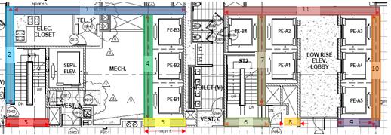
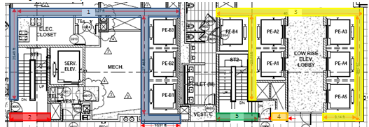
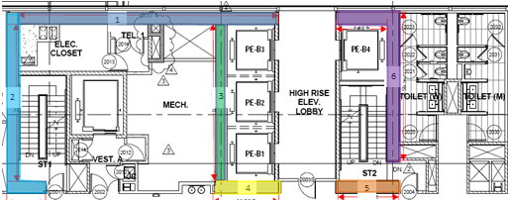
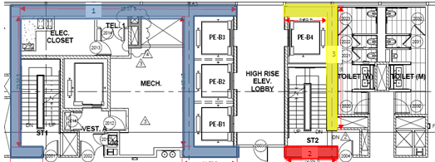
PENN STATE AE SENIOR THESIS PROJECT
SHIVAM PATEL|CONSTRUCTION MANAGEMENT OPTION
ADVISOR: DR GANNON
Turner Construction Company
Hines
SIPS
PROJECT BACKGROUND
RESEARCH TOPIC: MATERIAL TRACKING
ANALYSIS #1: GUIDED FORMWORK TO SELF-CLIMBING
ANALYSIS #2: PHOTOVOLTAIC CURTAIN WALL
ANALYSIS #3: SIPS
CONCLUSIONS
ACKNOWLEGEMENTS
ACTIVITY BREAKDOWN
Durations
44 and 30 Tons of rebar
246 and 172 Cubic Yards
10 hour workdays
1.26 and 1.2 tons/hour
Crew increase from 16 to 32 men
2.52 and 2.4 tons/hour
49.2 and 34.4 cubic yards/hour
Photos provided by Turner
Notes:
3 Bay (44 tons of Rebar Installed & 246 Cubic Yards of Concrete Installed)
2 Bay (30 tons of Rebar Installed & 172 Cubic Yard of Concrete Installed)
Decided to increase number of ironworkers from 16 men to 32 men.
Obvious increase in productivity due to number of ironworkers.
Able to install rebar and embeds in two walls now instead of one.
Concrete pump must pour at a rate of (49.2 cubic yards per hour for 3 bay and 34.4 cubic yards per hour for 2 bay)

Slide 17
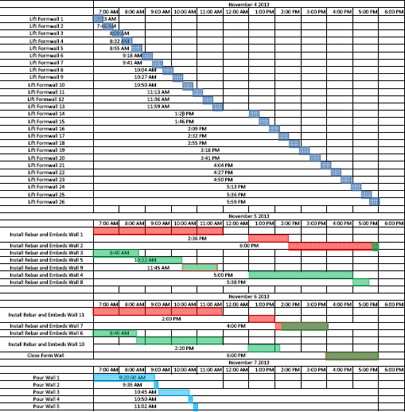
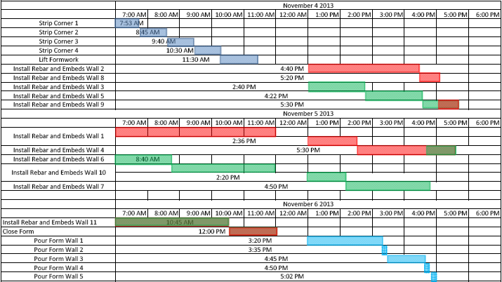
PENN STATE AE SENIOR THESIS PROJECT
SHIVAM PATEL|CONSTRUCTION MANAGEMENT OPTION
ADVISOR: DR GANNON
Turner Construction Company
Hines
SIPS
PROJECT BACKGROUND
RESEARCH TOPIC: MATERIAL TRACKING
ANALYSIS #1: GUIDED FORMWORK TO SELF-CLIMBING
ANALYSIS #2: PHOTOVOLTAIC CURTAIN WALL
ANALYSIS #3: SIPS
CONCLUSIONS
ACKNOWLEGEMENTS
SIPS SCHEDULES
Schedule Impact
Decreases 1 ½ days per week
Saves 30 working days
180 days for Xclimb (3/17/14)
150 days for Super Climber(2/19/14)
Notes:
Each schedule portrays a typical week
Noticed a 1 ½ day decrease per floor
Saves a total of 30 working days
180 total days for the Xclimb
150 total days for the Super Climber

Slide 18
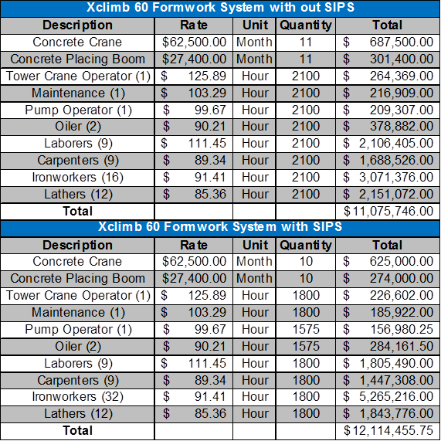
PENN STATE AE SENIOR THESIS PROJECT
SHIVAM PATEL|CONSTRUCTION MANAGEMENT OPTION
ADVISOR: DR GANNON
Turner Construction Company
Hines
SIPS
PROJECT BACKGROUND
RESEARCH TOPIC: MATERIAL TRACKING
ANALYSIS #1: GUIDED FORMWORK TO SELF-CLIMBING
ANALYSIS #2: PHOTOVOLTAIC CURTAIN WALL
ANALYSIS #3: SIPS
CONCLUSIONS
ACKNOWLEGEMENTS
COST IMPACT
Cost Impact
Xclimb 60: $1 Million increase
Super Climber: $570,000 Increase
Activities that follow core have potential to start sooner
Notes:
Cost impacts of increasing the ironworkers
Although the costs increase The activities that follow the concrete core such as the structural steel, superstructure, SOFP, etc can start sooner thus decreasing the schedule, and also decreasing the cost

Slide 19
PENN STATE AE SENIOR THESIS PROJECT
SHIVAM PATEL|CONSTRUCTION MANAGEMENT OPTION
ADVISOR: DR GANNON
Turner Construction Company
Hines
CONCLUSIONS
PROJECT BACKGROUND
RESEARCH TOPIC: MATERIAL TRACKING
ANALYSIS #1: GUIDED FORMWORK TO SELF-CLIMBING
ANALYSIS #2: PHOTOVOLTAIC CURTAIN WALL
ANALYSIS #3: SIPS
CONCLUSIONS
ACKNOWLEGEMENTS
FINAL RECOMMENDATION
Research Topic: Material Tracking Technologies
Cost $6,900 To Implement System
One Time Cost
Alleviates Potential Risks
Analysis #1: Guided Formwork To Self Climbing
Accelerated Schedule by 30 days
Increase Cost of $174,058.87
Saves $1,530,878 off General Conditions
Safer Working Conditions
Analysis #2: Photovoltaic Curtain Wall
Saves $1000 Off Electrical Bill
Increase in $615,120
Owner Sees Payback Within Two Years through Tax Incentives
Analysis #3: SIPS
Accelerated Schedule by 30 days
Increased Cost of $1 M and $570,000
Activities Potentially Can Start Sooner

Slide 20
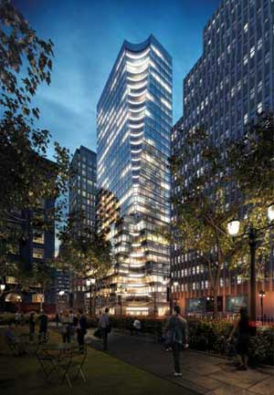
PENN STATE AE SENIOR THESIS PROJECT
SHIVAM PATEL|CONSTRUCTION MANAGEMENT OPTION
ADVISOR: DR GANNON
Turner Construction Company
Hines
ACKNOWLEDGMENTS
PROJECT BACKGROUND
RESEARCH TOPIC: MATERIAL TRACKING
ANALYSIS #1: GUIDED FORMWORK TO SELF-CLIMBING
ANALYSIS #2: PHOTOVOLTAIC CURTAIN WALL
ANALYSIS #3: SIPS
CONCLUSIONS
ACKNOWLEGEMENTS
Turner Construction Company
Hines
Dr Ed Gannon: Thesis Advisor
Penn State AE Faculty
Family
Fellow AE Students
Photos provided by Hines

Slide 21
PENN STATE AE SENIOR THESIS PROJECT
SHIVAM PATEL|CONSTRUCTION MANAGEMENT OPTION
ADVISOR: DR GANNON
Turner Construction Company
Hines
QUESTIONS
QUESTIONS?

Slide 22
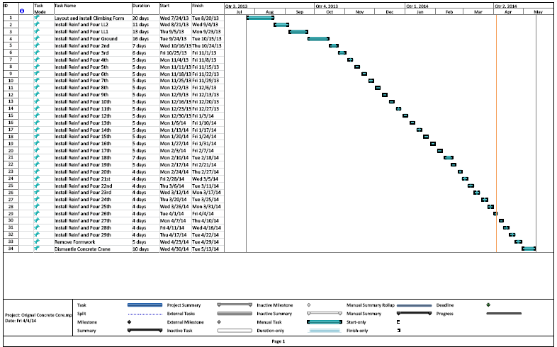
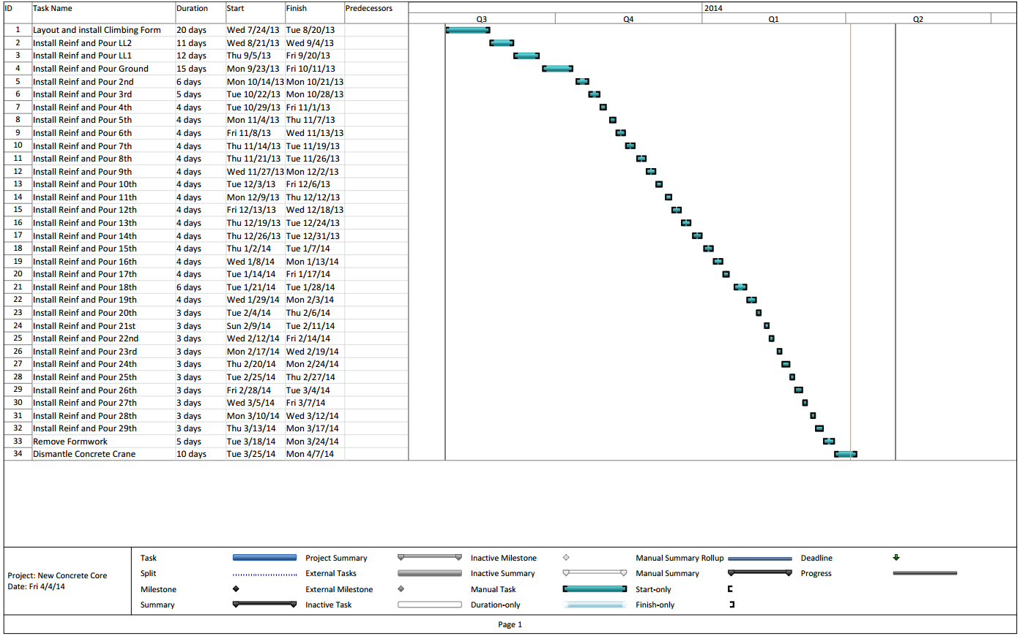
PENN STATE AE SENIOR THESIS PROJECT
SHIVAM PATEL|CONSTRUCTION MANAGEMENT OPTION
ADVISOR: DR GANNON
Turner Construction Company
Hines
APPENDICES

Slide 23
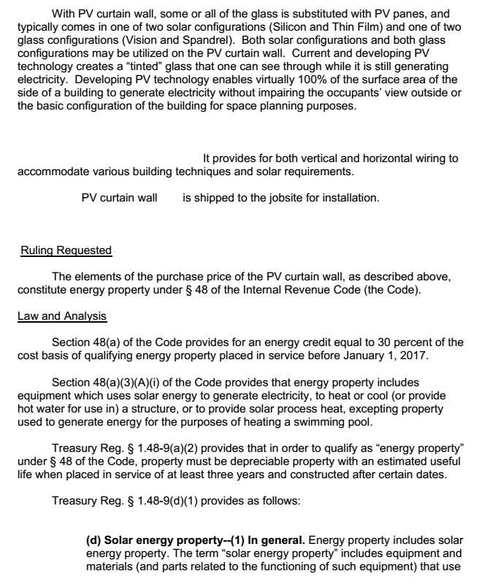
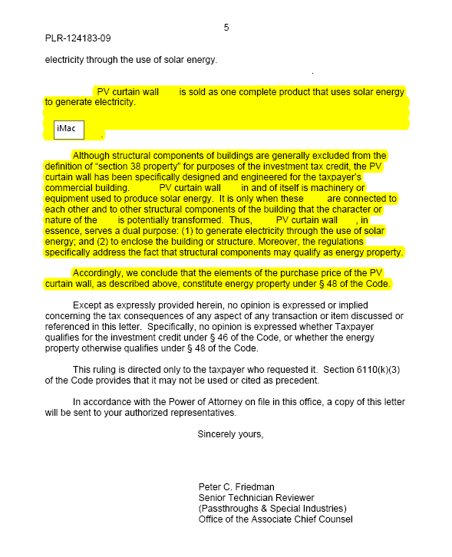
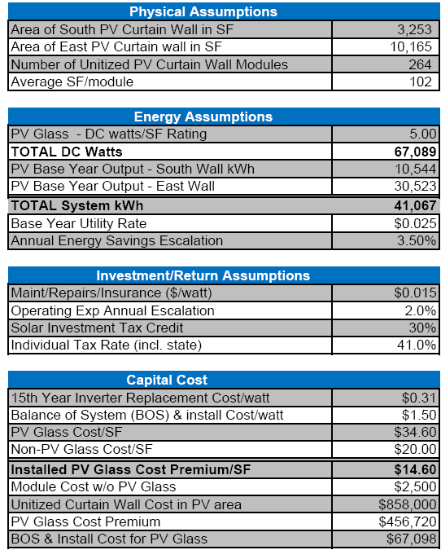
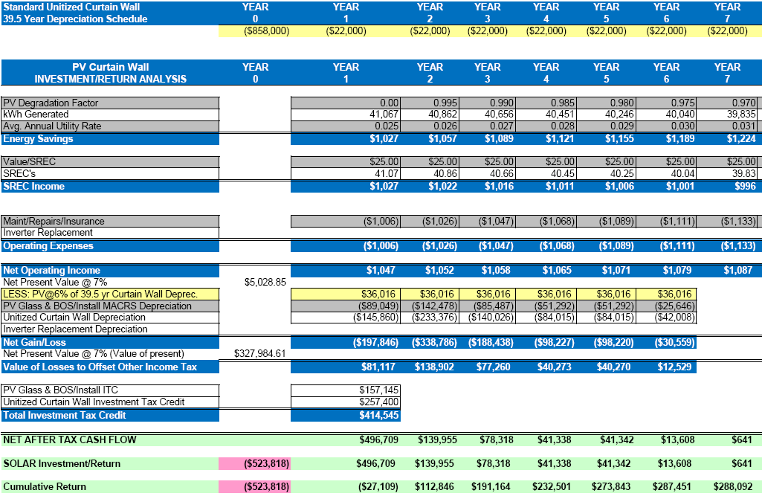
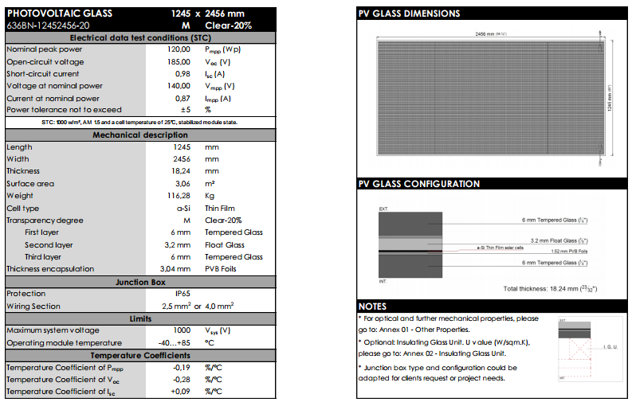
PENN STATE AE SENIOR THESIS PROJECT
SHIVAM PATEL|CONSTRUCTION MANAGEMENT OPTION
ADVISOR: DR GANNON
Turner Construction Company
Hines
APPENDICES

Slide 24
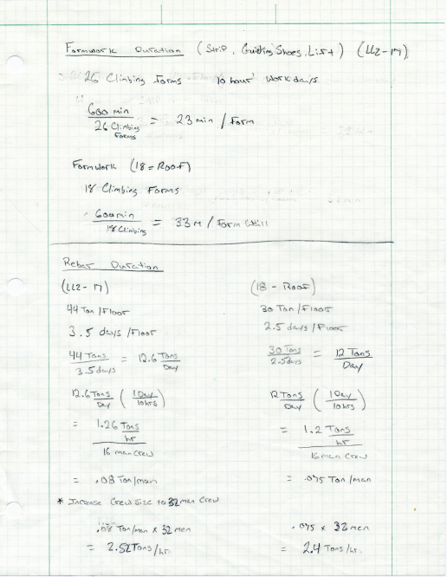
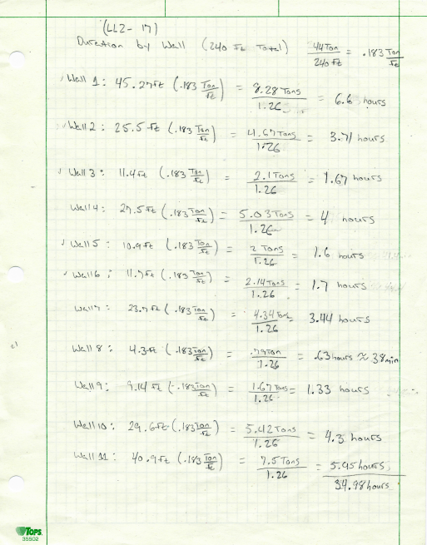




PENN STATE AE SENIOR THESIS PROJECT
SHIVAM PATEL|CONSTRUCTION MANAGEMENT OPTION
ADVISOR: DR GANNON
Turner Construction Company
Hines
APPENDICES

